Slide 1
CHMG-141 General and Analytical Chemistry I Lecture 6 (Ch. 2) with Dr. Bailey
Quantum Mechanical View of the Atom
Electron Energy, Electron Transitions
Quantum Numbers
The Shapes of Atomic Orbitals

Slide 2
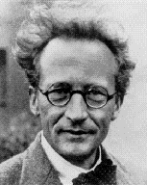
Erwin Schrödinger was the first to successfully apply the concept of the wave nature of matter to the electron configuration of an atom
Schrödinger’s equation, when solved, gives wave functions and energy levels for electrons trapped in them
Wave functions for electrons in atoms are called orbitals
E. Schrodinger
1887-1961

Slide 3
Electron Energy
for an electron with a given energy, the best we can do is describe a region in the atom of high probability of finding it – called an orbital
a probability distribution map of a region where the electron is likely to be found
wave Function, ψ
distance vs. ψ²
many of the properties of atoms are related to the energies of the electrons

Slide 4
Solutions of the Schrodinger equation
Solutions boiled down to rules for n, l, and m_{l}

Slide 5
Wave mechanics → Electron configuration
How exactly do we assign electrons to energy levels?
What use is the wave equation to us?
What can we filter out of Schrödinger’s equation to suit our needs?
Are there any Quantum Numbers that we can simply use to describe the electrons?
YES!!!!

Slide 6
Wave Function, ψ QUANTUM NUMBERS
Calculations show that the size, shape and orientation in space of an orbital are determined by three integer terms in the wave function
added to quantize the energy of the electron
these integers are called quantum numbers
principal quantum number, n
angular momentum (secondary) quantum number, l
magnetic quantum number, m_{l}

Slide 7
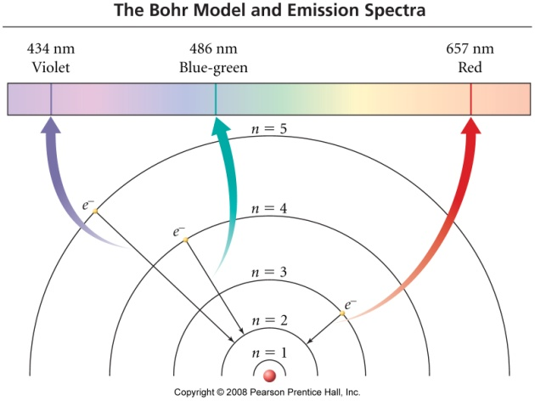
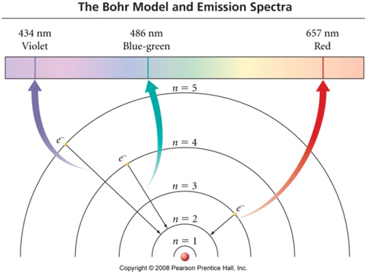
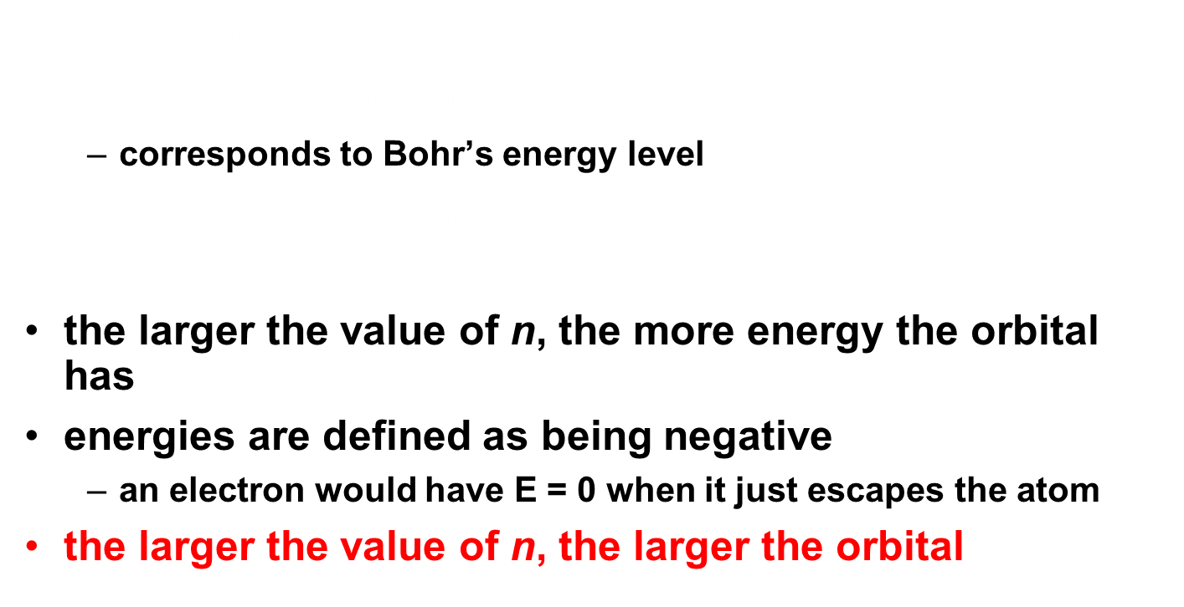


Principal Quantum Number, n

Slide 8
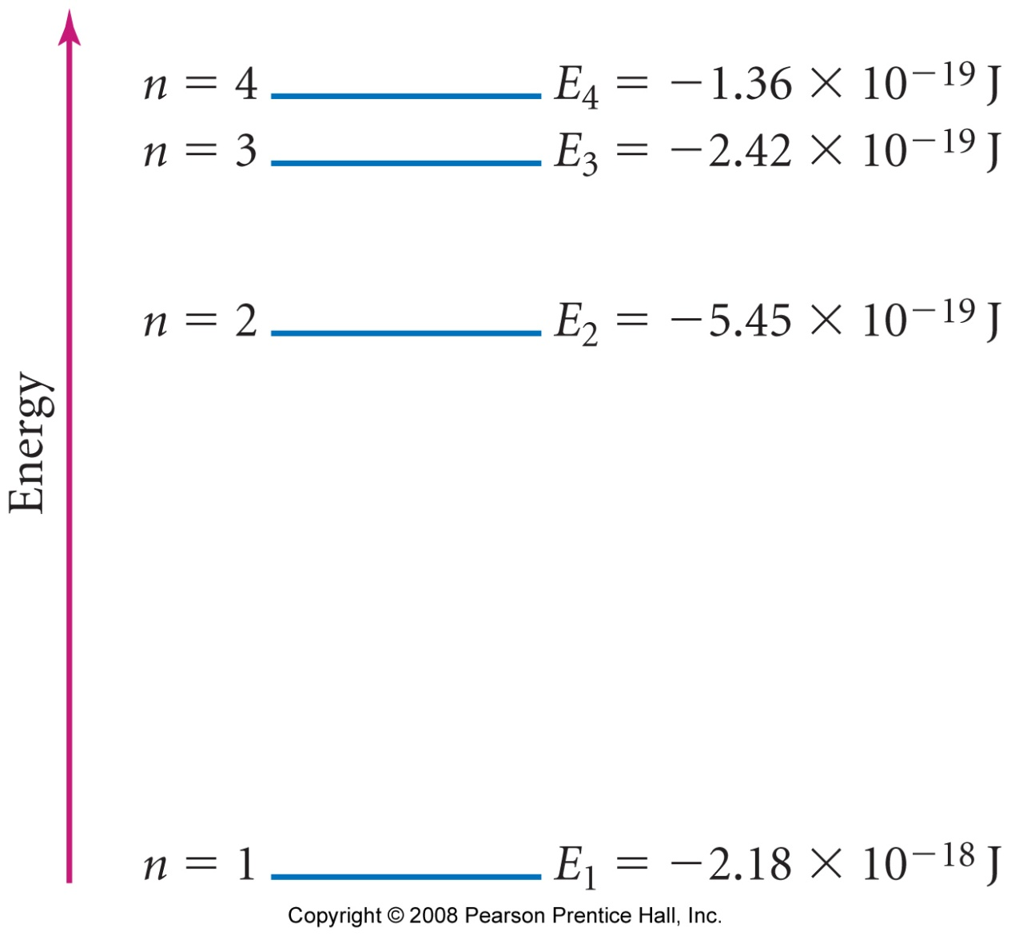
Principal Energy Levels in Hydrogen
as n gets larger, the amount of energy between orbitals gets smaller

Slide 9
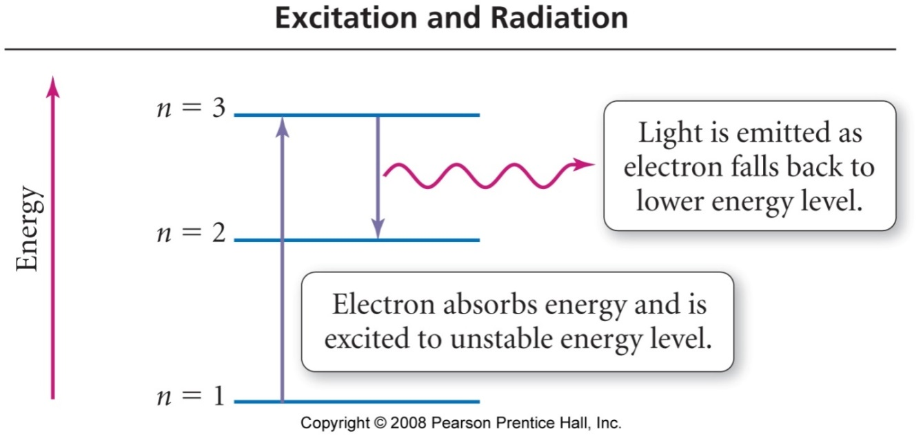
Electron Transitions
in order to transition to a higher energy state, the electron must gain the correct amount of energy corresponding to the difference in energy between the final and initial states (absorption)
Electrons in high energy states (exited) are unstable and tend to lose energy and transition to lower energy states
energy released as a photon of light (emission)
each line in the emission spectrum corresponds to the difference in energy between two energy states

Slide 10
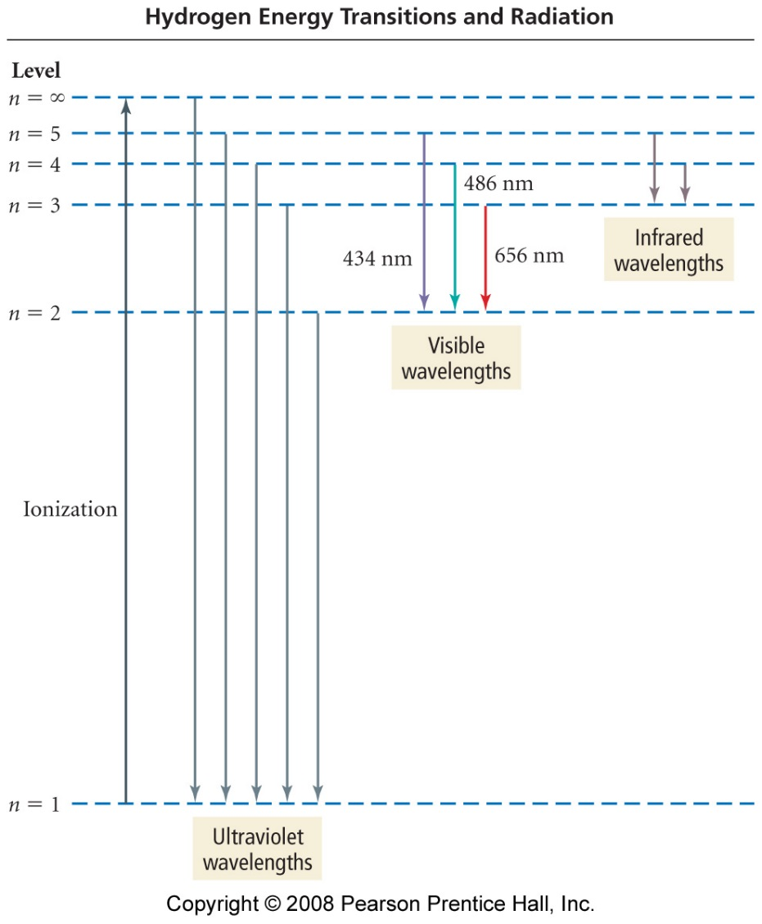
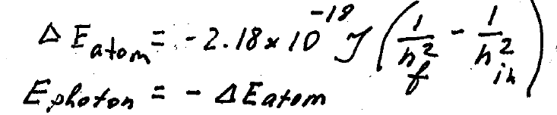
Predicting the Spectrum of Hydrogen
the wavelengths of lines in the emission spectrum of hydrogen can be predicted by calculating the difference in energy between any two states
for an electron in energy state n, there are (n – 1) energy states it can transition to, therefore (n – 1) lines it can generate. Example: if n=7, there are 21 lines
both the Bohr and Quantum Mechanical Models can predict these lines very accurately

Slide 11
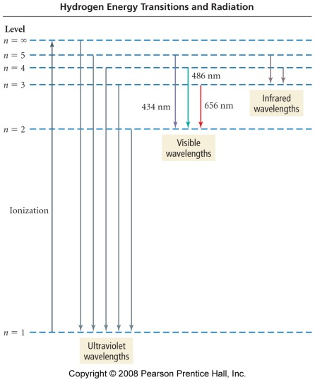
Example : Calculate the wavelength of light emitted when the hydrogen electron transitions from n = 6 to n = 5
Given:
Find:
n_{i} = 6, n_{f} = 5
λ, m
Concept Plan:
Relationships:
E=hc/λ, E_{n} = -2.18 x 10⁻¹⁸ J (1/n²)
n_{i}, n_{f}
ΔE_{atom}
E_{photon}
λ
ΔE_{atom} = -E_{photon}
Solve:
E_{photon} = -(-2.6644 x 10⁻²⁰ J) = 2.6644 x 10⁻²⁰ J
Check:
the unit is correct, the wavelength is in the infrared, which is appropriate because less energy than 4→2 (in the visible)

Slide 12
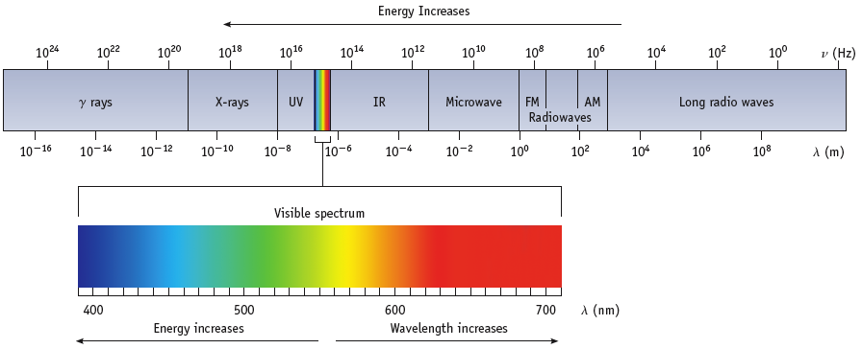
Electromagnetic Spectrum
Recall:
visible light comprises only a small fraction of all the wavelengths of light – called the electromagnetic spectrum
short wavelength (high frequency) light has high energy
radiowave light has the lowest energy
gamma ray light has the highest energy

Slide 13
Practice – Calculate the wavelength of light emitted when the hydrogen electron transitions from n = 2 to n = 1

Slide 14
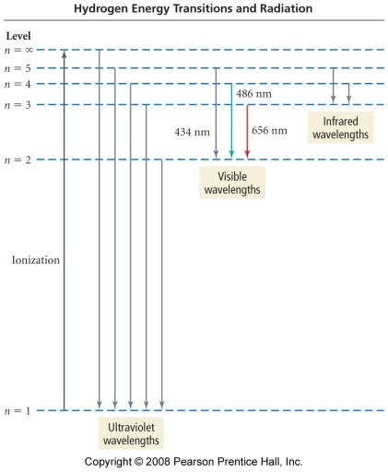
Calculate the wavelength of light emitted when the hydrogen electron transitions from n = 2 to n = 1
Practice:
Given:
Find:
n_{i} = 2, n_{f} = 1
λ, m
Concept Plan:
Relationships:
E=hc/λ, E_{n} = -2.18 x 10⁻¹⁸ J (1/n²)
n_{i}, n_{f}
ΔE_{atom}
E_{photon}
λ
ΔE_{atom} = -E_{photon}
Solve:
E_{photon} = -(-1.64 x 10⁻¹⁸ J) = 1.64 x 10⁻¹⁸ J
the unit is correct, the wavelength is in the UV, which is appropriate because more energy than 3→2 (in the visible)

Slide 15
Arrangement of Electrons in Atoms
Electrons in atoms are arranged as
SHELLS (n)
SUBSHELLS (l)
ORBITALS (m_{l})
Subshells grouped in shells.
Orbitals grouped in s, p, d (and f) subshells

Slide 16

Subshells & Shells
Each shell has a number called the PRINCIPAL QUANTUM NUMBER, n

Slide 17
Let’s come back…
Orbitals are characterized by a set of three quantum numbers:
n = principle (major) quantum number. All orbitals with the same principle quantum number are in the same shell.
Allowed values: the set of positive integers.
l = secondary quantum number which divides the orbitals in a shell into smaller groups called subshells.
Allowed values: from 0 to (n – 1).
m_{l} = magnetic quantum number which divides the subshells into individual orbitals.
Allowed values: integers from –l to +l.

Slide 18
QUANTUM NUMBERS
Symbol Values Description
n (major) 1, 2, 3, .. Orbital size and energy where E = -R(1/n²)
l (angular) 0, 1, 2, .. n-1 Orbital shape or type (subshell)
m_{l} (magnetic) -l..0..+l Orbital orientation
# of orbitals in subshell = 2 l + 1

Slide 19
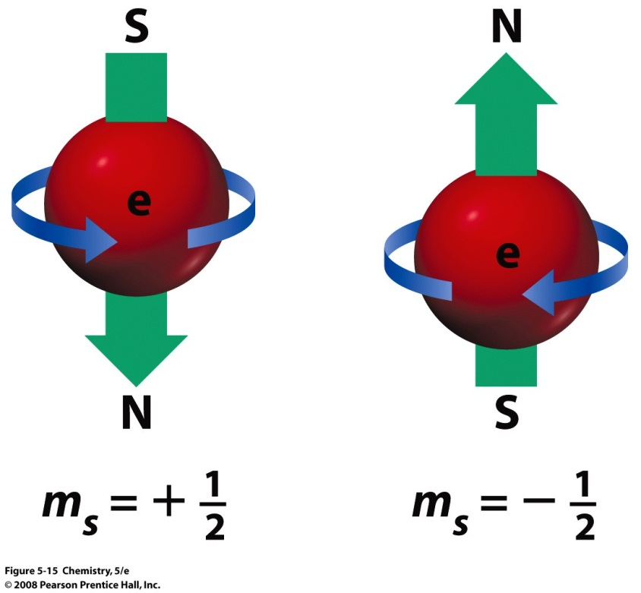
Electron Spin
Electrons behave like tiny magnets
There are two opposite directions in which the electron can spin in the presence of an external magnetic field
If one electron in an orbital has a clockwise spin, the other electron in the same orbital must have a counter-clockwise spin
This gives rise to the spin quantum number, m_{s} with allowed values of
+1/2 (spin “up”) or
–1/2 (spin “down”).
Each orbital can hold only (maximum) 2 electrons

Slide 20
QUANTUM NUMBERS
Now there are four!
n ---> shell 1, 2, 3, 4, ...
l ---> subshell 0, 1, 2, ... n - 1
m_{l} ---> orbital -l ... 0 ... +l
m_{s} ---> electron spin +1/2 and -1/2

Slide 21
Shells and Subshells
When n = 1, then l = 0 and m_{l} = 0
Therefore, in n = 1, there is 1 type of subshell
and that subshell has a single orbital
(m_{l} has a single value ---> 1 orbital)
This subshell is labeled s (“ess”)
Each shell has 1 orbital labeled s, and it is SPHERICAL in shape.

Slide 22
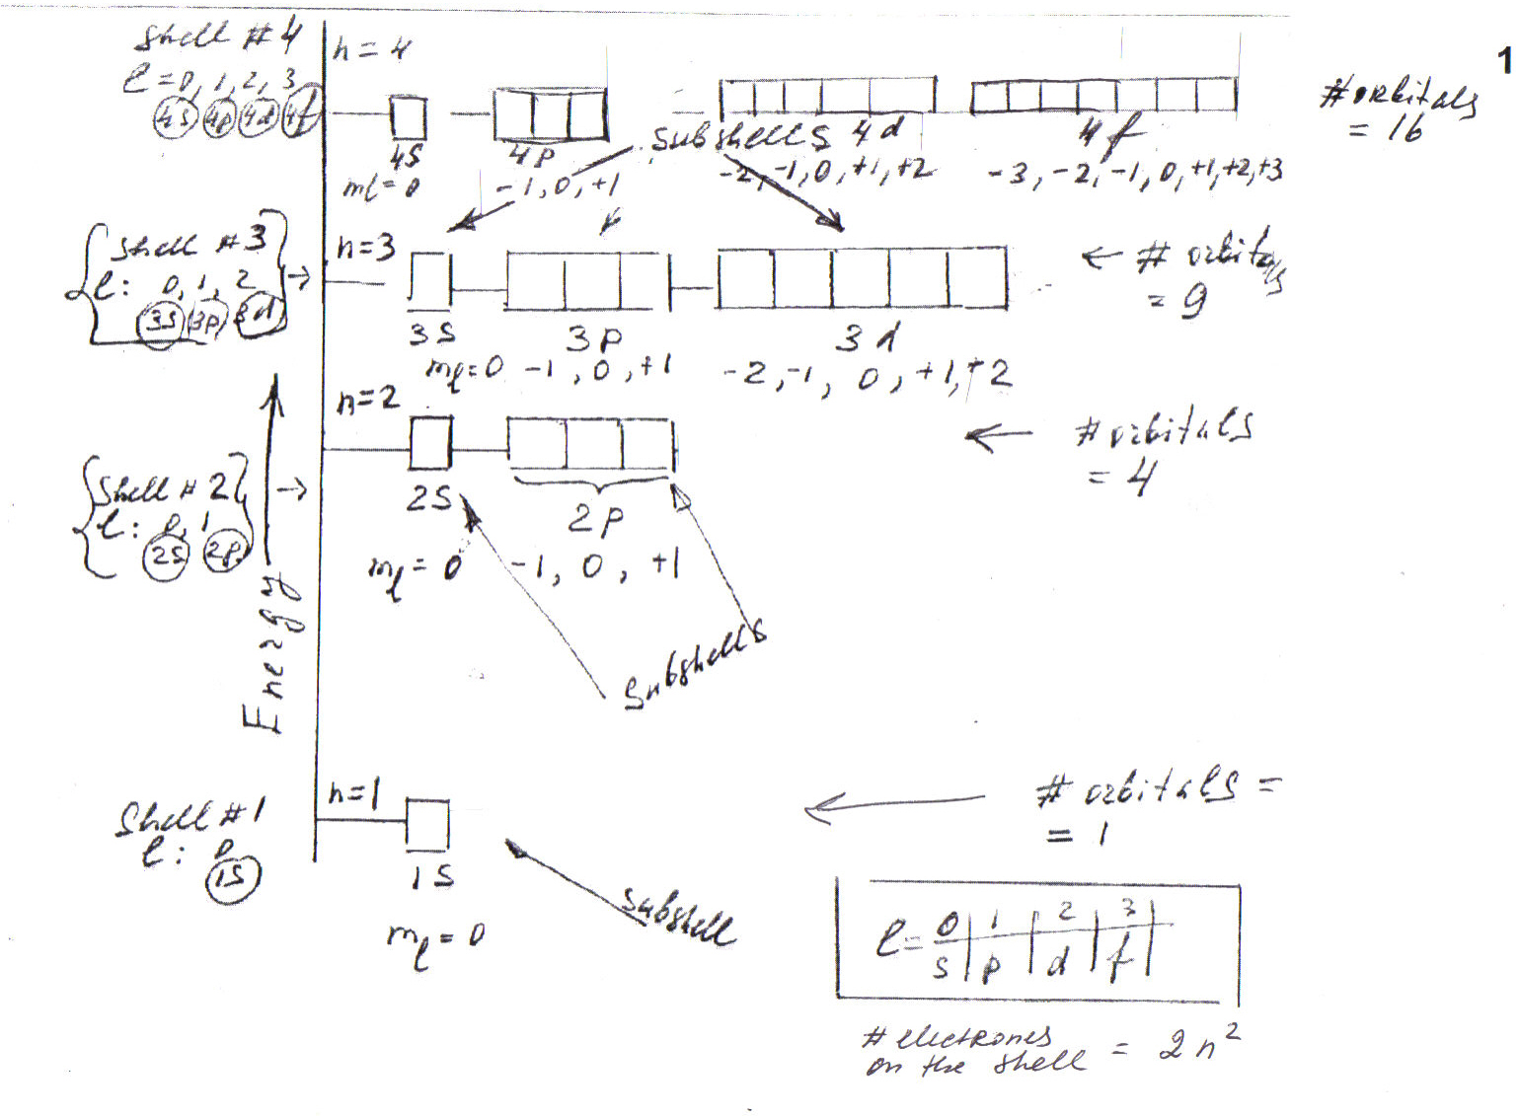

Slide 23
p Orbitals
When n = 2, then l = 0 and 1
Therefore, in n = 2 shell there are 2 types of orbitals — 2 subshells
For l = 0 m_{l} = 0
this is a s subshell
For l = 1 m_{l} = -1, 0, +1
this is a p subshell with 3 orbitals
When l = 1, there is a PLANAR NODE thru the nucleus.

Slide 24
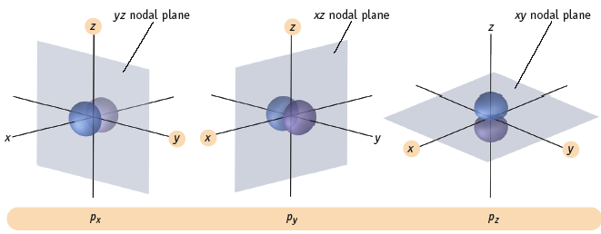
p Orbitals
The three p orbitals lie 90º apart in space

Slide 26
d Orbitals
When n = 3, what are the values of l?
l = 0, 1, 2
and so there are 3 subshells in the shell.
For l = 0, m_{l} = 0
---> s subshell with single orbital
For l = 1, m_{l} = -1, 0, +1
---> p subshell with 3 orbitals
For l = 2, m_{l} = -2, -1, 0, +1, +2
---> d subshell with 5 orbitals

Slide 27
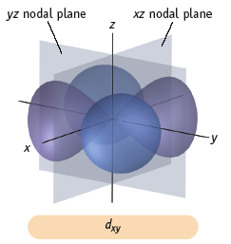
d Orbitals
s orbitals have no planar node (l = 0) and so are spherical.
p orbitals have l = 1, and have 1 planar node,
and so are “dumbbell” shaped.
This means d orbitals (with l = 2) have 2 planar nodes

Slide 29
f Orbitals
When n = 4, l = 0, 1, 2, 3 so there are 4 subshells in the shell.
For l = 0, m_{l} = 0
---> s subshell with single orbital
For l = 1, m_{l} = -1, 0, +1
---> p subshell with 3 orbitals
For l = 2, m_{l} = -2, -1, 0, +1, +2
---> d subshell with 5 orbitals
For l = 3, m_{l} = -3, -2, -1, 0, +1, +2, +3
---> f subshell with 7 orbitals

Slide 30
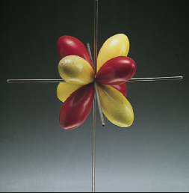
f — Orbitals
One of 7 possible f orbitals.
All have 3 planar surfaces.
Can you find the 3 surfaces here?

Slide 31
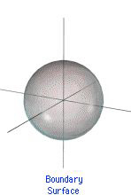
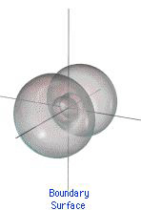
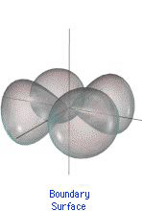
Types of Orbitals
s orbital
p orbital
d orbital
f orbital

Slide 33
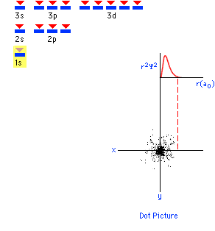
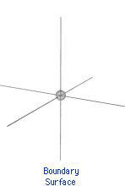
1s Orbital
the larger the value of n, the larger the orbital

Slide 34
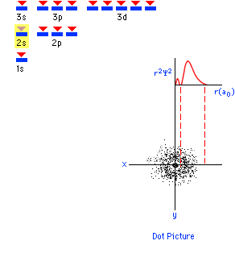
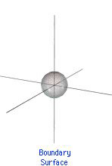
2s Orbital

Slide 35
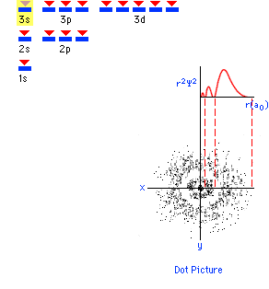
3s Orbital
f Orbitals…. n = 4…

Slide 36
Relationships between n, l, and m_{l}.
# of # of
n l m_{l} Subshell Orbitals Electrons
1 0 0 1s 1 2
2 0 0 2s 1 2
1 -1, 0, 1 2p 3 6
3 0 0 3s 1 2
1 -1, 0, 1 3p 3 6
2 -2, -1, 0, 1, 2 3d 5 10
4 0 0 4s 1 2
1 -1, 0, 1 4p 3 6
2 -2, -1, 0, 1, 2 4d 5 10
3 -3, -2, -1, 0, 1, 2, 3 4f 7 14
Can you see any pattern yet?

Slide 37
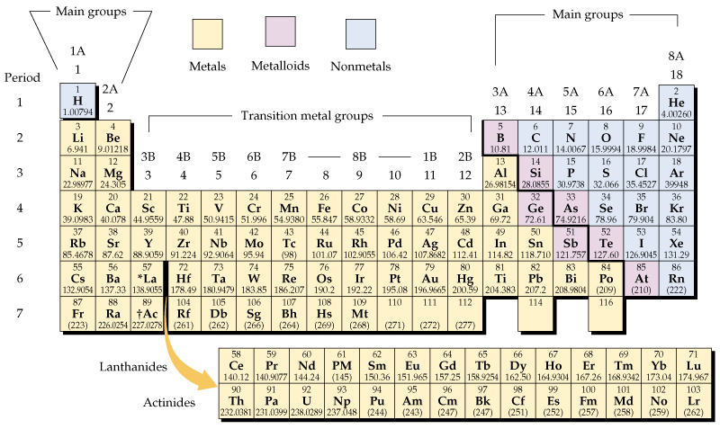
The periodic table

Slide 38
All orbitals with the same value of the principal quantum number are said to
belong to the same subshell
belong to the same class
belong to the same period
belong to the same shell
belong to the same group
10
0 of 5

Slide 39

All orbitals with the same value of the principal quantum number are said to
belong to the same subshell
belong to the same class
belong to the same period
belong to the same shell
belong to the same group
10
0 of 5

Slide 40
What is the total number of subshells in the second shell?
18
8
9
4
2

Slide 41

What is the total number of subshells in the second shell?
18
8
9
4
2 (s and p)

Slide 42
If there are 3 types of p orbitals, how many electrons can occupy the p subshell?
10
2
10
1
6

Slide 43
If there are 3 types of p orbitals, how many electrons can occupy the p subshell?
10
2
10
1
6

Slide 44
Given the following sets of quantum numbers for n l m_{l} m_{s}, which one of these sets is not a possible set for an electron in an atom?
n l m_{l} m_{s}
3 1 -1 ½
4 3 -2 -½
5 2 3 ½
4 3 2 ½
3 2 2 -½
10
0 of 5

Slide 45
Given the following sets of quantum numbers for n l m_{l} m_{s}, which one of these sets is not a possible set for an electron in an atom?
n l m_{l} m_{s}
3 1 -1 ½
4 3 -2 -½
5 2 3 ½
4 3 2 ½
3 2 2 -½
n ---> shell 1, 2, 3,4, ...
l ---> subshell 0, 1, 2, ... n - 1
m_{l} ---> orbital -l ... 0 ... +l
m_{s} ---> electron spin +1/2 and -1/2
10
0 of 5

Slide 46
What is the total number of orbitals in the second shell?
18
8
9
4
2

Slide 47
What is the total number of orbitals in the second shell?
18
8
9
4
2

Slide 48
What is the total number of orbitals in the third shell?
18
8
9
4
2

Slide 49
What is the total number of orbitals in the third shell?
18
8
9
4
2

Slide 50
If there are 7 types of f orbitals, how many electrons can occupy the f subshell?
10
7
10
21
14

Slide 51
If there are 7 types of f orbitals, how many electrons can occupy the f subshell?
10
7
10
21
14

Slide 52
The letter designation for the subshell is based on
the value of the spin quantum number, m_{s}
the value of the magnetic quantum number, m_{l}
the value of the secondary quantum number
the value of the principal quantum number
10
0 of 5

Slide 53
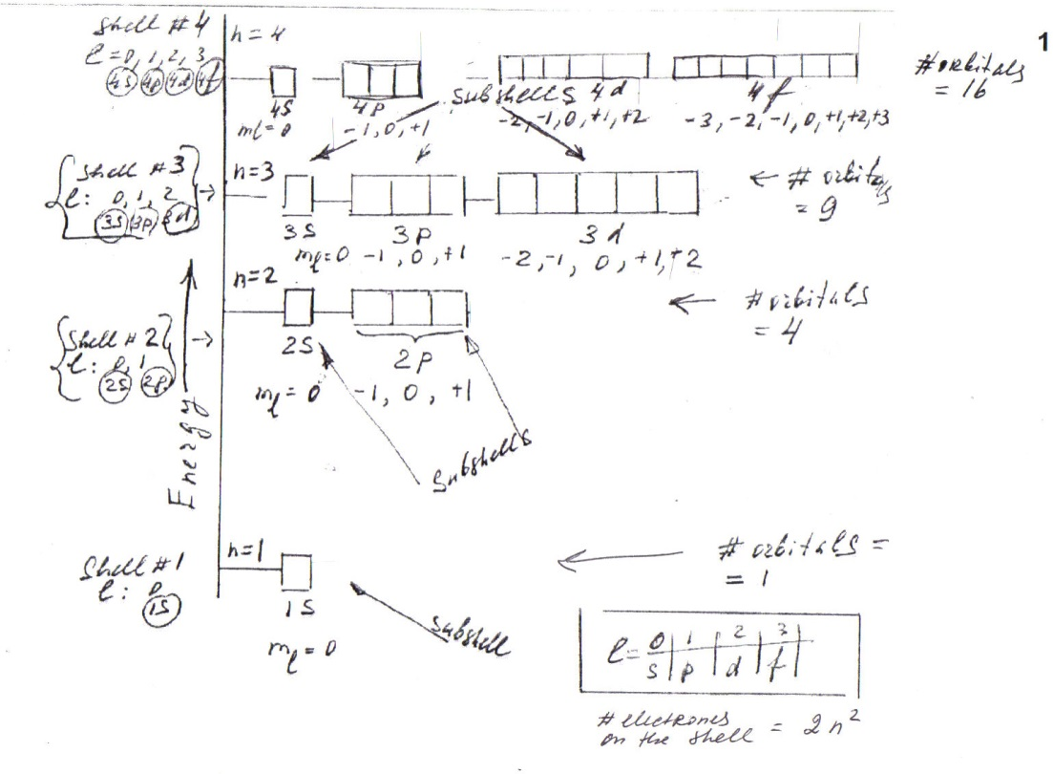
The letter designation for the subshell is based on
the value of the spin quantum number, m_{s}
the value of the magnetic quantum number, m_{l}
the value of the secondary quantum number
the value of the principal quantum number
10
0 of 5

Slide 54
The spectroscopic notation (number + letter designation) for the subshell with n = 4 and l = 2 is
4p subshell
there is no subshell fitting this description
4s subshell
4d subshell
4f subshell
10
0 of 5

Slide 55
The spectroscopic notation (number + letter designation) for the subshell with n = 4 and l = 2 is
4p subshell
there is no subshell fitting this description
4s subshell
4d subshell
4f subshell
10
0 of 5

Slide 56
Why is quantum mechanics important to us?
It addresses the physics of very small particles
It tells us that light is particulate as well as wave-like
It allows us to predict and understand the electron configuration of an atom
It shows us that electrons can be emitted from sodium
10
0 of 5

Slide 58
Relationships between n, l, and m_{l}.
# of # of
n l m_{l} Subshell Orbitals Electrons
1 0 0 1s 1 2
2 0 0 2s 1 2
1 -1, 0, 1 2p 3 6
3 0 0 3s 1 2
1 -1, 0, 1 3p 3 6
2 -2, -1, 0, 1, 2 3d 5 10
4 0 0 4s 1 2
1 -1, 0, 1 4p 3 6
2 -2, -1, 0, 1, 2 4d 5 10
3 -3, -2, -1, 0, 1, 2, 3 4f 7 14
Can you see any pattern yet?

Slide 59
The periodic table

Slide 60
Subshells & Shells
n = 1
n = 2
n = 3
n = 4
The principal quantum number of the shell is the number of the period or row of the periodic table where that shell begins.

